Slide 1

Unifying QA, Dialog, VQA and Visual Dialog
Jason Weston
Facebook AI Research
Collaborators: A. Bordes, Y. Boureau, S. Chopra, J. Dodge, R. Fergus, A. Fisch, A. Gane, M. Henaff, F. Hill, A. Joulin, Y. LeCun, B. van Merriënboer, J. Li, T. Mikolov, A. Miller, A.M. Rush, S. Sukhbaatar, A. Szlam, X. Zhang

Slide 2
Why Dialog for NLP researchers?
The purpose of language is to use it to accomplish communication goals.
Hence, solving dialog is a fundamental goal for NLP.
Dialog can be seen as a single task (learning how to talk)
or
as thousands of related tasks that require different skills,
all using the same input and output format
E.g. the task of booking a restaurant, chatting about sports or the news, or answering factual or perceptually-grounded questions all fall under dialog. …I could go on.. and almost anything can be posed as QA

Slide 3
Why Dialog for vision researchers?
You tell me!
Some reasons I can think of:
Vision has got to the point where linking to speech acts or motor actions makes sense..
Vision has always mapped to e.g. text labels to see if a model “understands”. QA & Dialog are more sophisticated tests.
Dialog is an interface to humans, which links to more applications
Language: possible output and input which gives richer learning possibilities.

Slide 4
Why Dialog for ML researchers?
From a machine learning perspective, different dialog tasks require:
task transfer
logical and commonsense reasoning
memory
learning from interaction
learning compositionality
data efficiency
planning
..and more!

Slide 5
Why Dialog for ML researchers?
From a machine learning perspective, different dialog tasks require:
task transfer
logical and commonsense reasoning
memory
learning from interaction
learning compositionality
data efficiency
planning
..and more!
mentioned by Derek Hoeim earlier today
Marcus Rohrbach earlier today
Sanja Fidler

Slide 6
Some Recent History of QA/Dialog
QA as search over KBs
WebQuestions, WikiMovies, SimpleQuestions
QA as machine reading
SQuAD, bAbI tasks, QACNN, CBT, MCTest
QA as machine reading at scale
SQuAD w/o paragraph, MS MARCO, WikiQA
Dialog as goal-oriented
bAbI-dialog, Frames
Dialog as chit-chat
Reddit, Twitter, Ubuntu

Slide 7
Dialog Tasks Motivate/Drive Algorithms
Example story + QA:
Antoine went to the kitchen. Antoine got the milk. Antoine travelled to the office. Antoine dropped the milk. Sumit picked up the football. Antoine went to the bathroom. Sumit moved to the kitchen.
where is the milk now? A: office
where is the football? A: kitchen
where is Antoine ? A: bathroom
where is Sumit ? A: kitchen
where was Antoine before the bathroom? A: office

Slide 8
Memory Network Models
Addressing:
score m_{i} w.r.t. q
Read:
return best m_{i}
[Figure by Saina Sukhbaatar]

Slide 9
bAbI Tasks (Weston et al., ‘15)
Set of 20 tasks testing basic reasoning capabilities from simulated stories
Useful to foster innovation: cited 220+ times, used to evaluate new methods
Attention during mem lookup
20 bAbI Tasks
1k training set
 | Test Acc | Failed tasks
LSTM | 49% | 20
MemN2N 1 hop | 74.8% | 17
2 hops | 84.4% | 11
3 hops | 87.6.% | 11

Slide 10
Memory Network Models
Some related models:
RNN-Search (Bahdanau et al.’14), NTM (Graves et al, ‘14), Stack RNNs (Joulin & Mikolov, ’15, Grefenstette et al, ‘15), Dynamic Mem. Nets (Kumar et al., ‘15), DNC (Graves et al., ’16), MemN2N (Sukhbaatar et al.)…
Addressing:
score m_{i} w.r.t. q
Read:
return best m_{i}
[Figure by Saina Sukhbaatar]

Slide 11
Memory Network Models
Some related models:
RNN-Search (Bahdanau et al.’14), NTM (Graves et al, ‘14), Stack RNNs (Joulin & Mikolov, ’15, Grefenstette et al, ‘15), Dynamic Mem. Nets (Kumar et al., ‘15), DNC (Graves et al., ’16), MemN2N (Sukhbaatar et al.)…
15th Oct 2014
20th Oct 2014
1st Sep 2014
Addressing:
score m_{i} w.r.t. q
Read:
return best m_{i}
[Figure by Saina Sukhbaatar]

Slide 12
bAbI - 10k training examples
10k training set
 | Test Acc | Failed tasks
LSTM | 36.4% | 16
D-NTM | 12.8% | 9
MemN2N (3 hops) | 4.2% | 3
DNC | 3.8% | 2
Dynamic MemNet | 2.8% | 1
EntNet (1 hop) | 0.5% | 0
QRN (Seo et al) | 0.3% | 0

Slide 13
bAbI 1k and 10k comparisons
Data efficiency / task transfer mentioned by Derek Hoeim earlier today
1k training set 10k training set
 | Test Acc | Failed tasks
LSTM | 51% | 20
NTM | ??? | ???
MemN2N (3 hops) | 12.4.% | 11
DNC | ??? | ???
Dynamic MemNet | 24.9% | 12
EntNet (1 hop) | 29.6% | 15
QRN | 11.3% | 5
 | Test Acc | Failed tasks
LSTM | 36.4% | 16
D-NTM | 12.8% | 9
MemN2N (3 hops) | 4.2% | 3
DNC | 3.8% | 2
Dynamic MemNet | 2.8% | 1
EntNet (1 hop) | 0.5% | 0
QRN (Seo et al) | 0.3% | 0

Slide 14
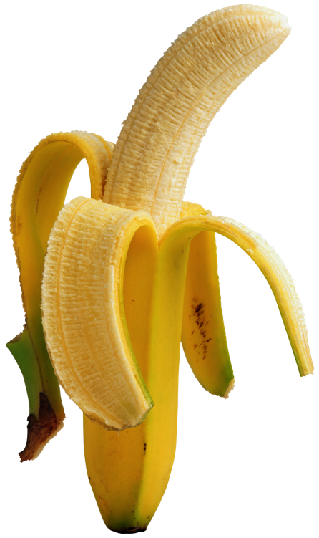
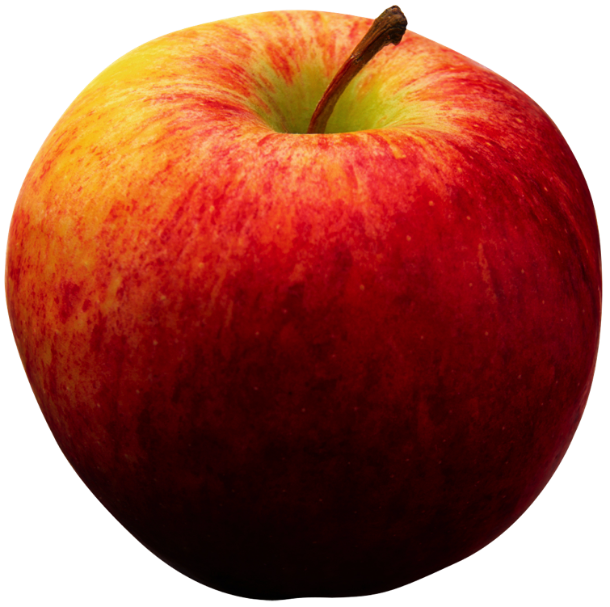

So we still fail on some tasks….
.. and we could also make more tasks that we fail on!
Our hope is that a feedback loop of:
Developing tasks that break models, and
Developing models that can solve tasks
… leads in a fruitful research direction….

Slide 15
How about on real data?
Toy AI tasks are important for developing innovative methods.
But they do not give all the answers.
How do these models work on real data?
Story understanding (Children’s Book Test, News e.g. QACNN)
Open Question Answering (WebQuestions, WikiQA, SQuAD)
Goal-Oriented Dialog and Chit-Chat (Movie Dialog, Ubuntu)

Slide 16
QA on REAL children’s stories
Predict missing word in a sentence given 20 previous sentences as multiple choice task.

Slide 17
Results on Children’s Book Test
Showed that language modeling should focus on named entities / nouns, as that’s the hard problem compared to human performance.
Requires memory + reasoning. Memory Networks perform well.

Slide 18
Results on Children’s Book Test
Many New Models And Results Since Then
Text Understanding with the Attention Sum Reader Network. Kadlec et al. ’16 CBT-NE: 71.0 CBT-CN: 68.9 Uses RNN style encoding of words + bypass module + 1 hop
Iterative Alternating Neural Attention for Machine Reading. Sordoni et al. ’16 CBT-NE: 72.0 CBT-CN: 71.0
Natural Language Comprehension with the EpiReader. Trischler et al. ’16 CBT-NE: 71.8 CBT-CN: 70.6
Gated-Attention Readers for Text Comprehension. Dhingra et al. ’16 CBT-NE: 71.9 CBT-CN: 69.0 Uses RNN style encoding of words + bypass module + multiplicative combination of query + multiple hops
Requires memory + reasoning: further improving the models.

Slide 19
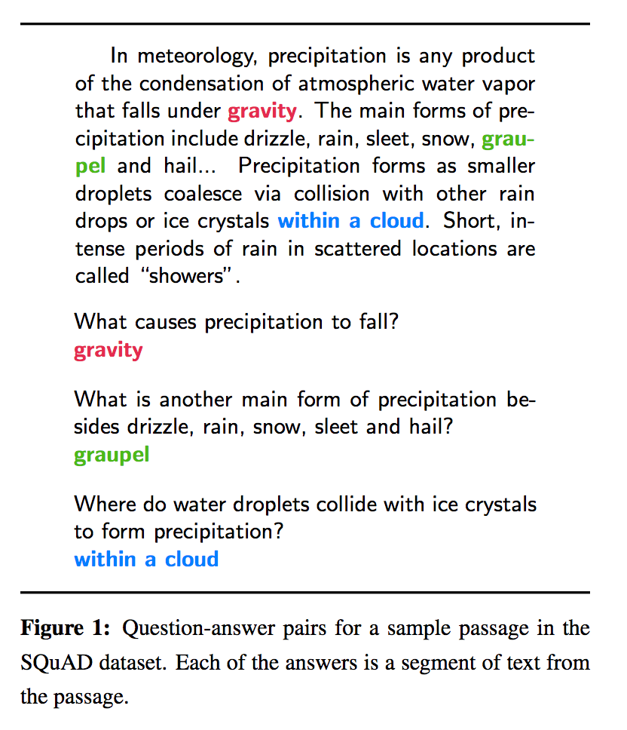
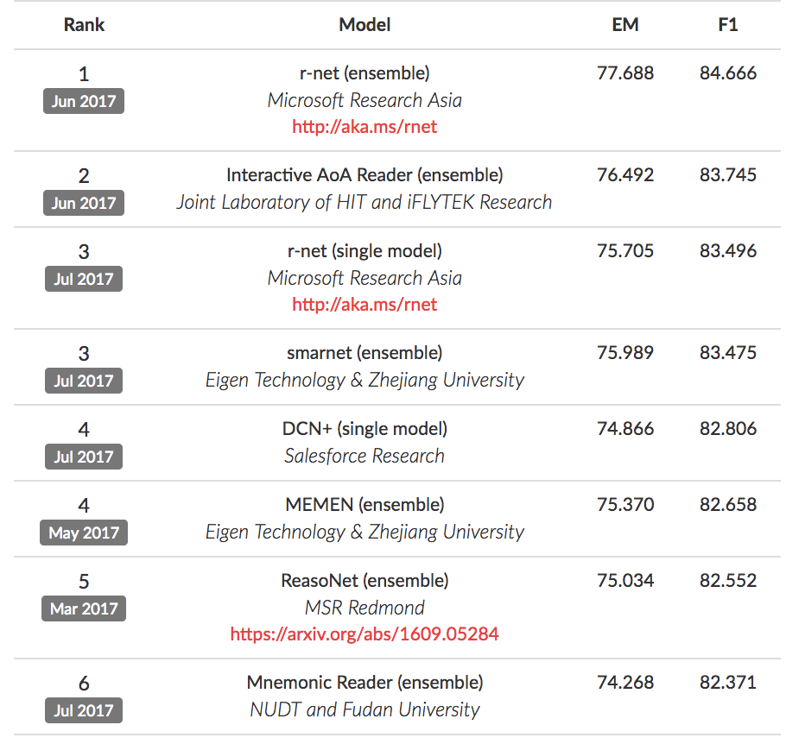
SQuAD dataset

Slide 20

WARNING
Working on individual datasets can lead to siloed research,overfitting to specific qualities of a task that don’t generalize to other tasks.
For example, methods that do not generalize beyond:
WebQuestions (Berant et al., ‘13) because they specialize on knowledge bases only,
SQuAD (Rajpurkar et al, ’16) because they predict start and end context indices; relies on word-overlap
bAbI (Weston et al., ‘15) because they use supporting facts or make use of its simulated nature.
CBT or QACNN aren’t really QA or dialogue tasks (closer to LM)
We want to find models/ideas that work on many tasks!!!!

Slide 21
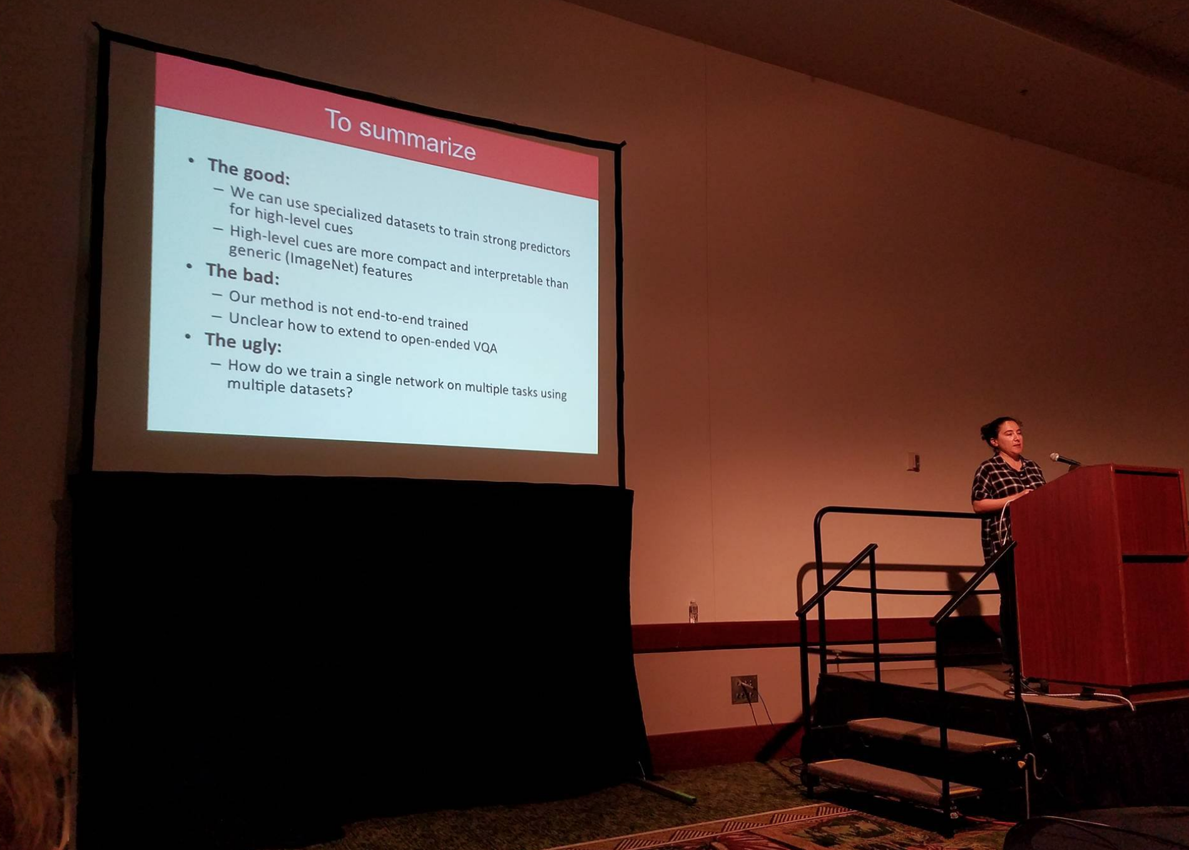
Svetlana Lazebnik
1st talk today

Slide 22
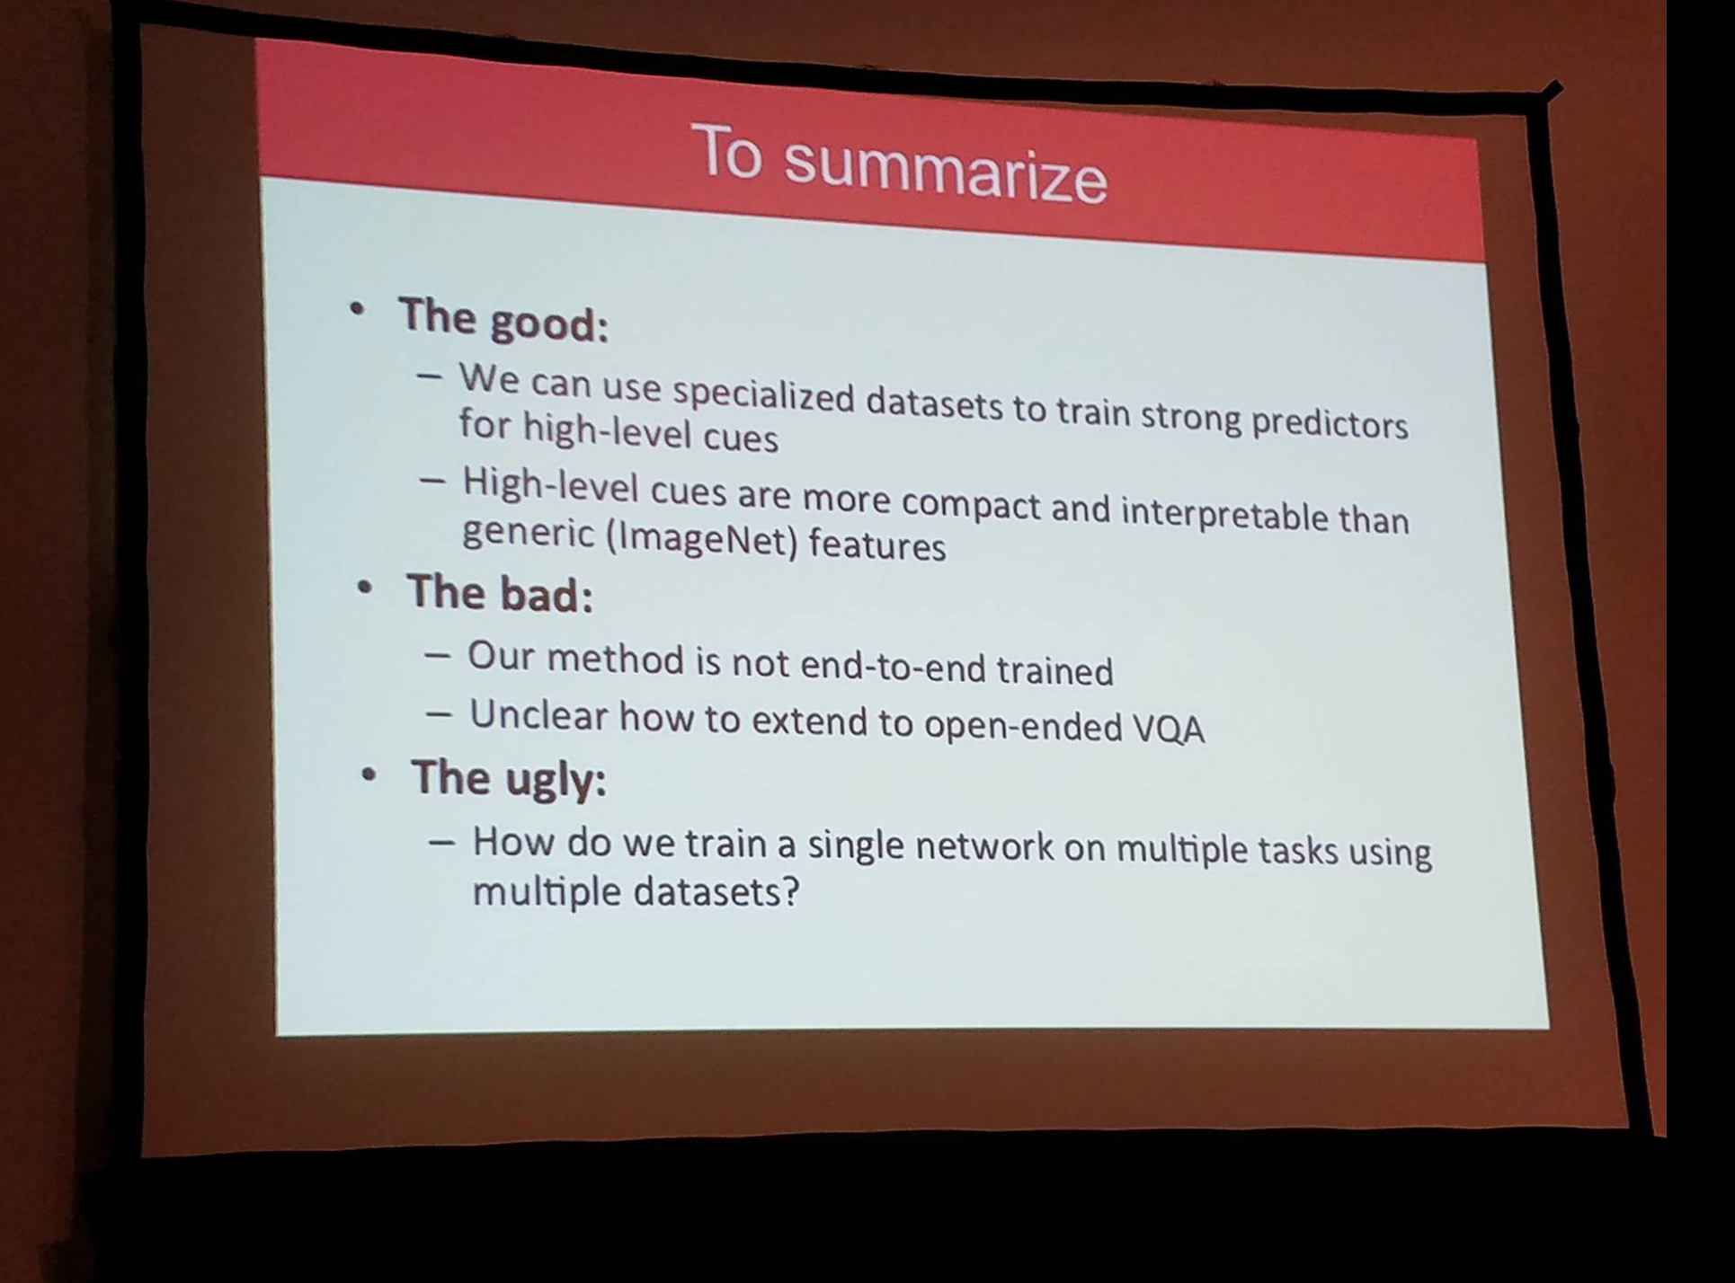

Slide 23

ParlAI (pronounced “par-lay”) is a framework for dialog research, implemented in Python. Its goal is to provide the community: - a unified framework for training and testing dialog models - a repository of both learning agents and tasks, use both to iterate research! - seamless integration of Amazon Mechanical Turk for data collection and human evaluation Over 20 tasks are supported, including popular datasets such as: SQuAD, MCTest, WikiQA, WebQuestions, SimpleQuestions, WikiMovies, QACNN & QADailyMail, CBT, BookTest, bAbI tasks, bAbI Dialog tasks, Ubuntu Dialog, OpenSubtitles, Cornell Movie, VQA, VisDial & CLEVR.
ParlAI: A platform for training and evaluating dialog agents on a variety of openly available datasets.
Check it out: http://parl.ai
Alexander H. Miller, Will Feng, Adam Fisch, Jiasen Lu, Dhruv Batra, Antoine Bordes, Devi Parikh, Jason Weston

Slide 24
What Tasks are Inside?
Current Snapshot
QA datasets SQuAD, MS MARCO, TriviaQA
bAbI tasks MCTest SimpleQuestions WikiQA, WebQuestions, InsuranceQA
WikiMovies, MTurkWikiMovies MovieDD (Movie-Recommendations)
Sentence Completion QACNN
QADailyMail CBT BookTest
Dialog Goal-Oriented bAbI Dialog tasks, personalized-dialog
Dialog-based Language Learning bAbI Dialog-based Language Learning Movie MovieDD-QARecs dialogue)
Dialog Chit-Chat Ubuntu Movies SubReddit Cornell Movie
OpenSubtitles
VQA/Visual Dialog VQA-v1,
VQA-v2, VisDial, CLEVR
Add your own dataset! Open source…

Slide 25
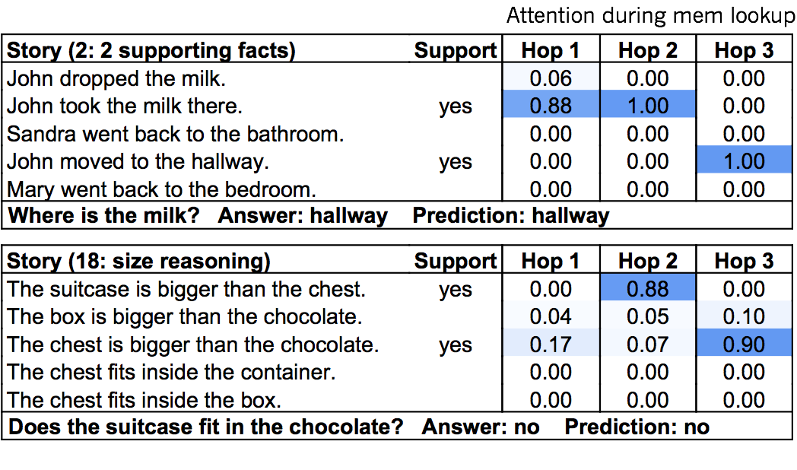
What Tasks are Inside?
QA datasets bAbI tasks MCTest SquAD, NewsQA, MS MARCO
SimpleQuestions WebQuestions, WikiQA
WikiMovies, MTurkWikiMovies MovieDD (Movie-Recommendations)
Sentence Completion QACNN
QADailyMail CBT BookTest
Dialogue Goal-Oriented bAbI Dialog tasks Camrest Dialog-based Language Learning MovieDD (QA,Recs dialogue) CommAI-env
Dialogue Chit-Chat Ubuntu multiple-choice UbuntuGeneration Movies SubReddit Reddit
Twitter
VQA/Visual Dialogue TBD..
Add your own dataset! Open source…

Slide 26
What Tasks are Inside?
QA datasets bAbI tasks MCTest SquAD, NewsQA, MS MARCO
SimpleQuestions WebQuestions, WikiQA
WikiMovies, MTurkWikiMovies MovieDD (Movie-Recommendations)
Sentence Completion QACNN
QADailyMail CBT BookTest
Dialogue Goal-Oriented bAbI Dialog tasks Camrest Dialog-based Language Learning MovieDD (QA,Recs dialogue) CommAI-env
Dialogue Chit-Chat Ubuntu multiple-choice UbuntuGeneration Movies SubReddit Reddit
Twitter
VQA/Visual Dialogue TBD..
Add your own dataset! Open source…

Slide 27
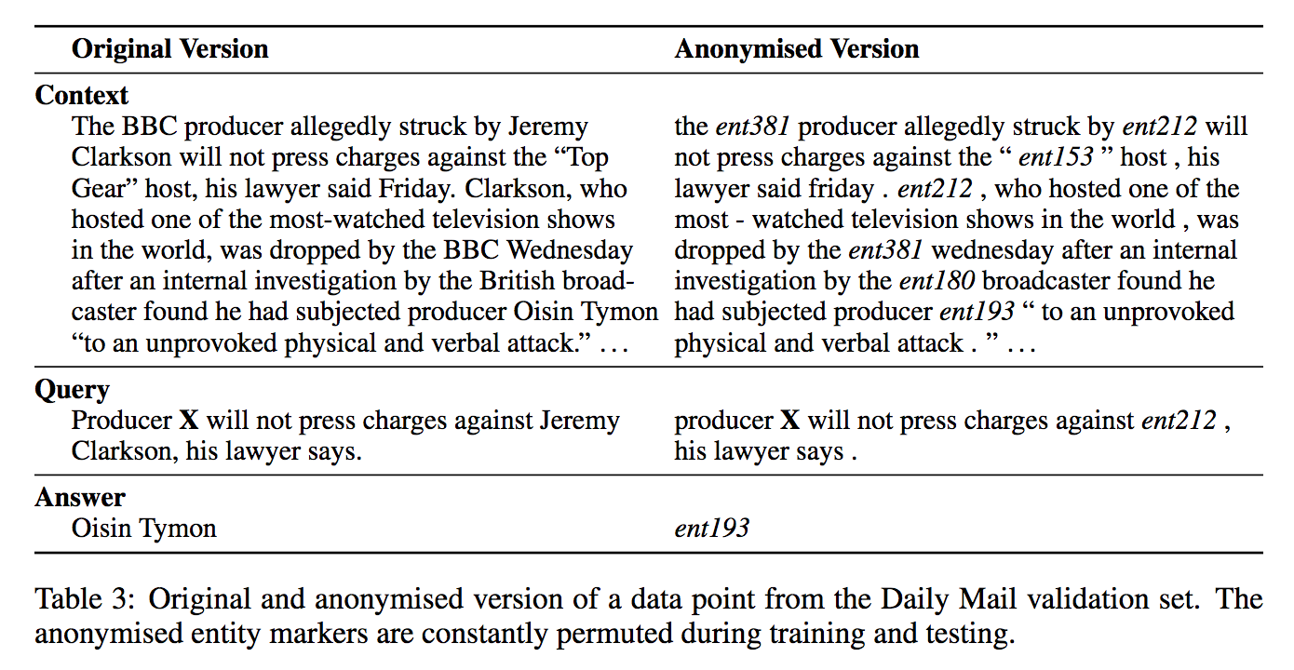
What Tasks are Inside?
QA datasets bAbI tasks MCTest SquAD, NewsQA, MS MARCO
SimpleQuestions WebQuestions, WikiQA
WikiMovies, MTurkWikiMovies MovieDD (Movie-Recommendations)
Sentence Completion QACNN
QADailyMail CBT BookTest
Dialogue Goal-Oriented bAbI Dialog tasks Camrest Dialog-based Language Learning MovieDD (QA,Recs dialogue) CommAI-env
Dialogue Chit-Chat Ubuntu multiple-choice UbuntuGeneration Movies SubReddit Reddit
Twitter
VQA/Visual Dialogue TBD..
Add your own dataset! Open source…

Slide 28
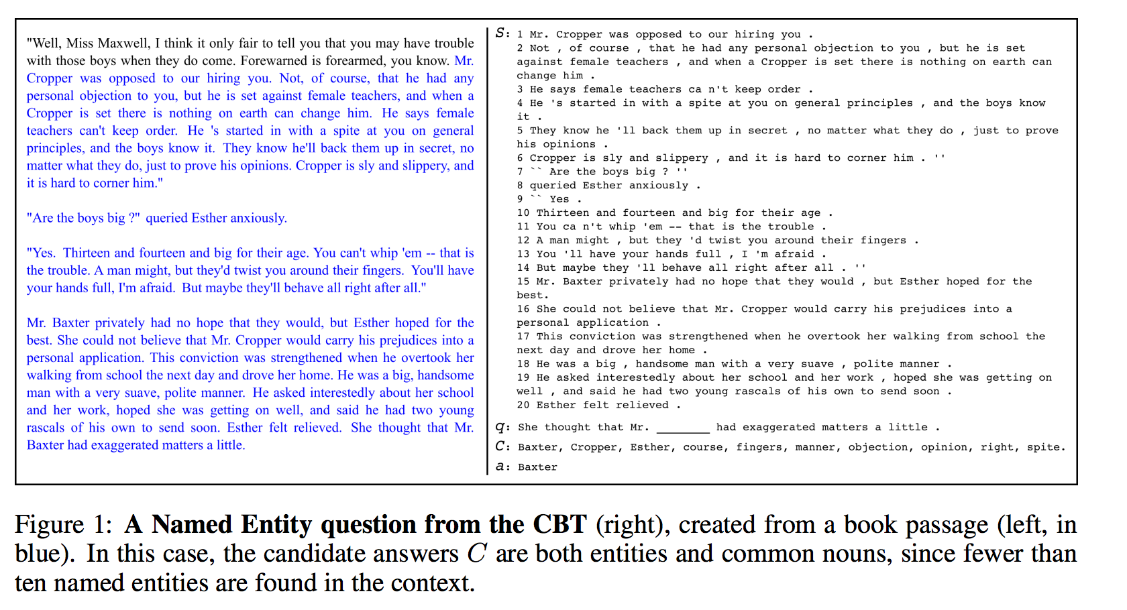
What Tasks are Inside?
QA datasets bAbI tasks MCTest SquAD, NewsQA, MS MARCO
SimpleQuestions WebQuestions, WikiQA
WikiMovies, MTurkWikiMovies MovieDD (Movie-Recommendations)
Sentence Completion QACNN
QADailyMail CBT BookTest
Dialogue Goal-Oriented bAbI Dialog tasks Camrest Dialog-based Language Learning MovieDD (QA,Recs dialogue) CommAI-env
Dialogue Chit-Chat Ubuntu multiple-choice UbuntuGeneration Movies SubReddit Reddit
Twitter
VQA/Visual Dialogue TBD..
Add your own dataset! Open source…

Slide 29
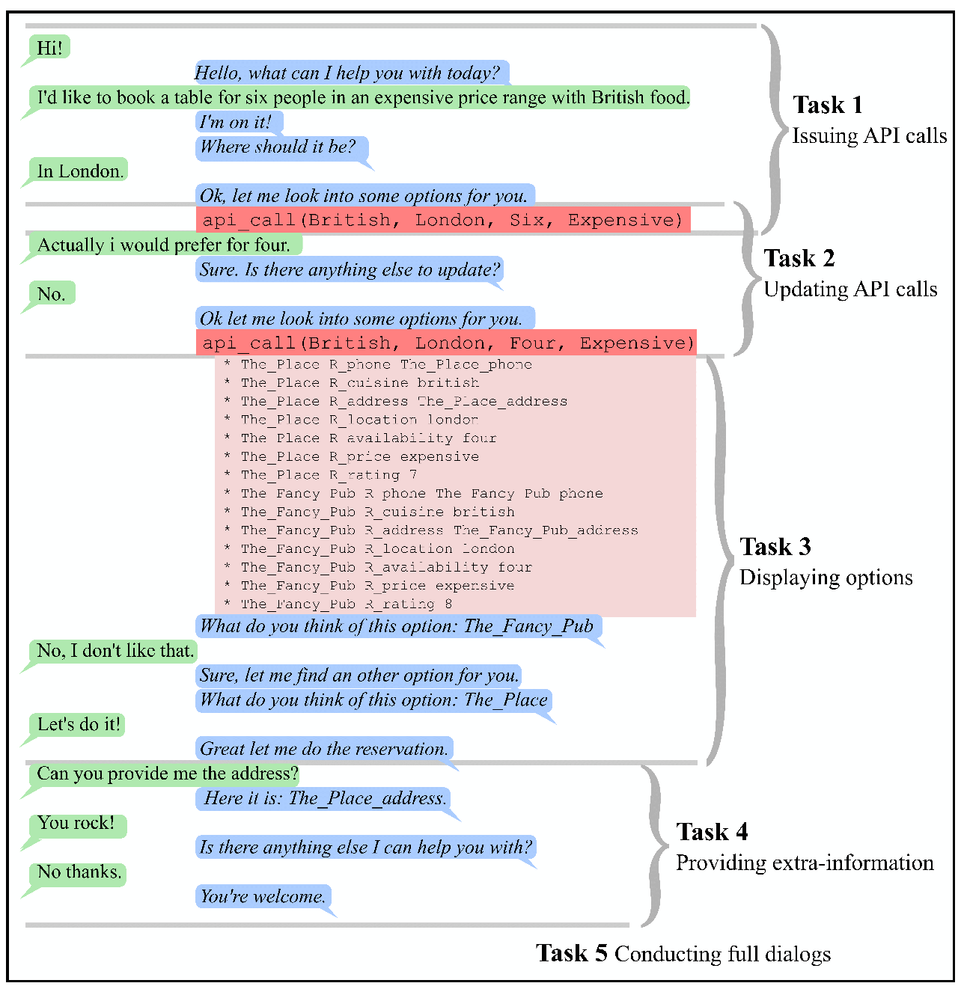
What Tasks are Inside?
QA datasets bAbI tasks MCTest SquAD, NewsQA, MS MARCO
SimpleQuestions WebQuestions, WikiQA
WikiMovies, MTurkWikiMovies MovieDD (Movie-Recommendations)
Sentence Completion QACNN
QADailyMail CBT BookTest
Dialogue Goal-Oriented bAbI Dialog tasks Camrest Dialog-based Language Learning MovieDD (QA,Recs dialogue) CommAI-env
Dialogue Chit-Chat Ubuntu multiple-choice UbuntuGeneration Movies SubReddit Reddit
Twitter
VQA/Visual Dialogue TBD..
Add your own dataset! Open source…

Slide 30
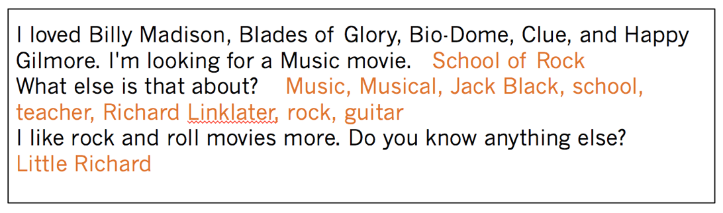
What Tasks are Inside?
QA datasets bAbI tasks MCTest SquAD, NewsQA, MS MARCO
SimpleQuestions WebQuestions, WikiQA
WikiMovies, MTurkWikiMovies MovieDD (Movie-Recommendations)
Sentence Completion QACNN
QADailyMail CBT BookTest
Dialogue Goal-Oriented bAbI Dialog tasks Camrest Dialog-based Language Learning MovieDD (QA,Recs dialogue) CommAI-env
Dialogue Chit-Chat Ubuntu multiple-choice UbuntuGeneration Movies SubReddit Reddit
Twitter
VQA/Visual Dialogue TBD..
Add your own dataset! Open source…

Slide 31
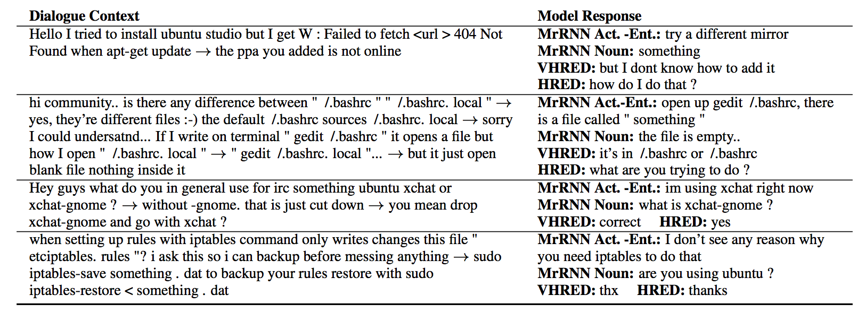
What Tasks are Inside?
QA datasets bAbI tasks MCTest SquAD, NewsQA, MS MARCO
SimpleQuestions WebQuestions, WikiQA
WikiMovies, MTurkWikiMovies MovieDD (Movie-Recommendations)
Sentence Completion QACNN
QADailyMail CBT BookTest
Dialogue Goal-Oriented bAbI Dialog tasks Camrest Dialog-based Language Learning MovieDD (QA,Recs dialogue) CommAI-env
Dialogue Chit-Chat Ubuntu multiple-choice UbuntuGeneration Movies SubReddit Reddit
Twitter
VQA/Visual Dialogue TBD..
Add your own dataset! Open source…

Slide 32
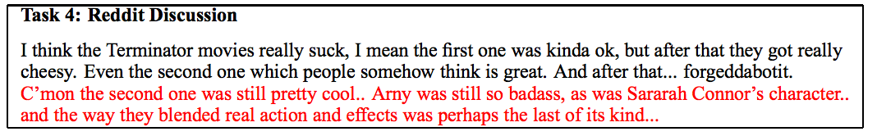
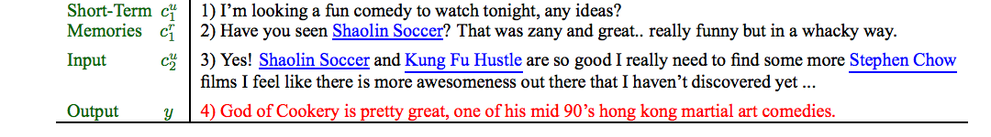
What Tasks are Inside?
QA datasets bAbI tasks MCTest SquAD, NewsQA, MS MARCO
SimpleQuestions WebQuestions, WikiQA
WikiMovies, MTurkWikiMovies MovieDD (Movie-Recommendations)
Sentence Completion QACNN
QADailyMail CBT BookTest
Dialogue Goal-Oriented bAbI Dialog tasks Camrest Dialog-based Language Learning MovieDD (QA,Recs dialogue) CommAI-env
Dialogue Chit-Chat Ubuntu multiple-choice UbuntuGeneration Movies SubReddit Reddit
Twitter
VQA/Visual Dialogue TBD..
Add your own dataset! Open source…

Slide 33
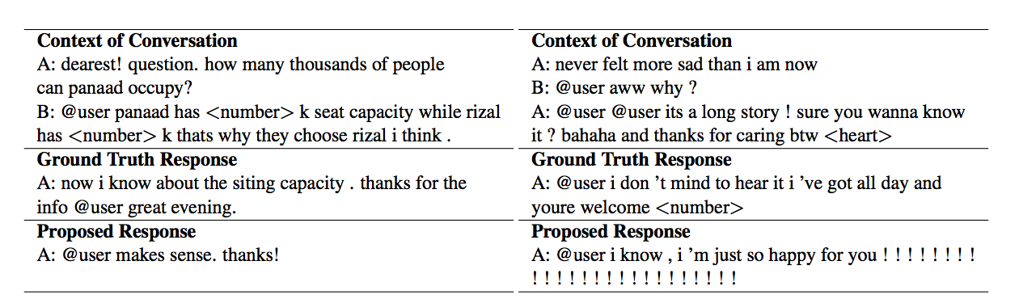
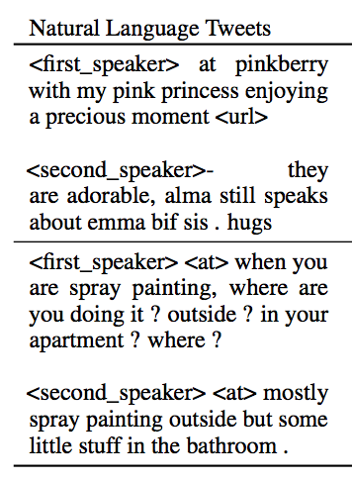
What Tasks are Inside?
QA datasets bAbI tasks MCTest SquAD, NewsQA, MS MARCO
SimpleQuestions WebQuestions, WikiQA
WikiMovies, MTurkWikiMovies MovieDD (Movie-Recommendations)
Sentence Completion QACNN
QADailyMail CBT BookTest
Dialogue Goal-Oriented bAbI Dialog tasks Camrest Dialog-based Language Learning MovieDD (QA,Recs dialogue) CommAI-env
Dialogue Chit-Chat Ubuntu multiple-choice UbuntuGeneration Movies SubReddit Reddit
Twitter
VQA/Visual Dialogue TBD..
Add your own dataset! Open source…

Slide 34
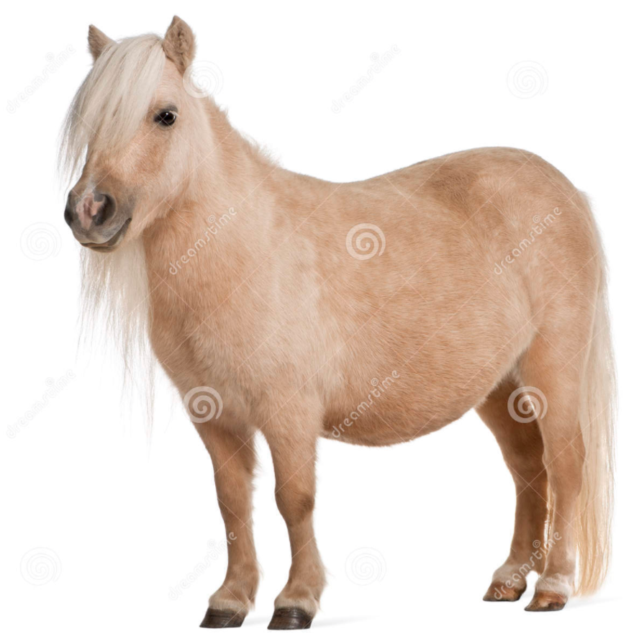
Why Unify?
We want models that aren’t just one-trick
We can find model weaknesses & iterate
We can study task transfer, compositionality,..
Maybe one day we can get close to AI ;)
-> an agent that is good at (all?) dialog

Slide 35
Why Dialog for ML researchers?
From a machine learning perspective, different dialog tasks require:
task transfer
logical and commonsense reasoning
memory
learning from interaction
learning compositionality
planning
..and more!

Slide 36
Learning From Human Responses
Mary went to the hallway.
John moved to the bathroom.
Mary travelled to the kitchen.
Where is Mary? A:playground
No, that's incorrect.
Where is John? A:bathroom
Yes, that's right!
If you can predict this, you are most of the way to knowing how to answer correctly.

Slide 37
Human Responses Give Lots of Info
Mary went to the hallway.
John moved to the bathroom.
Mary travelled to the kitchen.
Where is Mary? A:playground
No, the answer is kitchen.
Where is John? A:bathroom
Yes, that's right!
Much more signal than just “No” or zero reward.
Related to Sanja Fidler‘s talk!!!!!

Slide 38
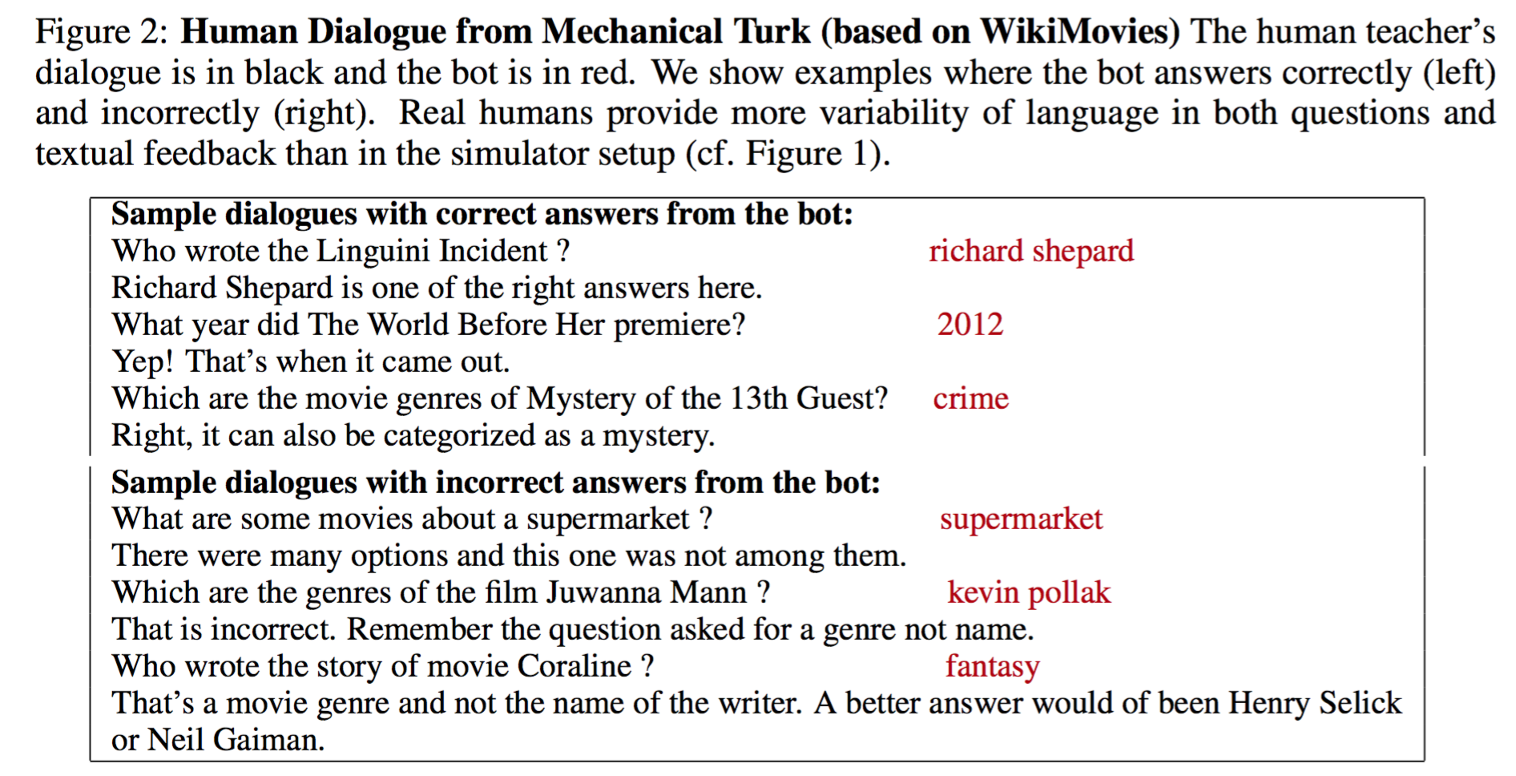
Real Human Questions+Feedback
Much more diversity!!

Slide 39
Forward Prediction Memory Network (Weston, ‘16)
new state of world
“Unsupervised” Forward Model: does not require labeled supervision

Slide 40
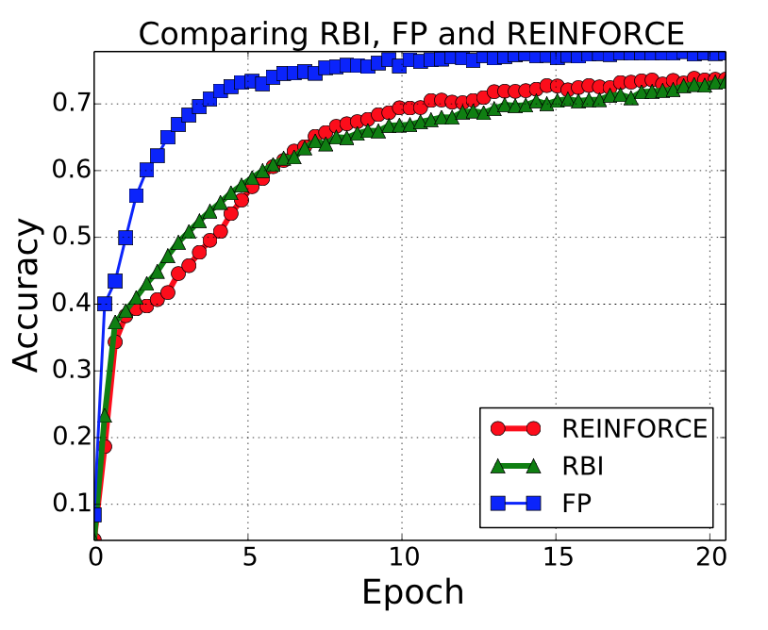
Dialog Feedback: Results
WikiMovies
Forward Prediction MemNN (FP) which uses textual rewards
can perform better than using numerical rewards (RBI or REINFORCE)!!

Slide 41
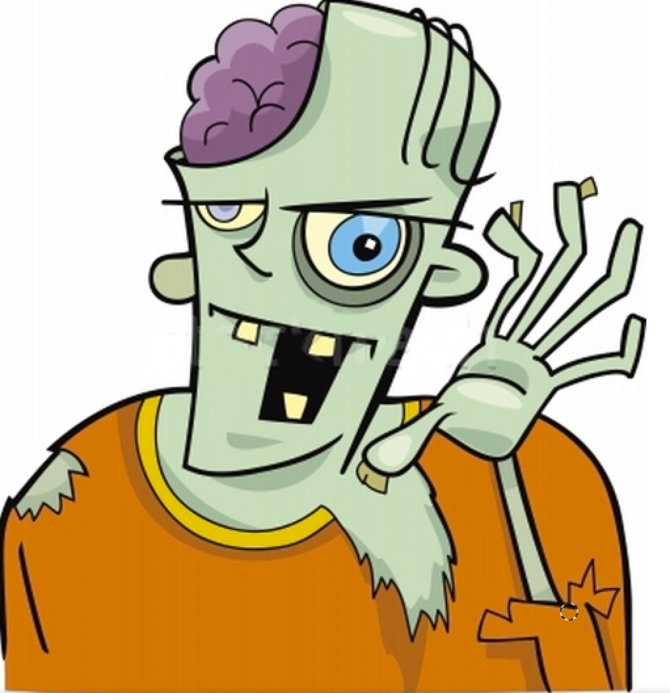
Conclusion Dialog is an excellent testbed for research: - iterate over dialog task creation and model innovation… ..to solve fundamental ML subtasks! - dialog gives us chance to learn while conversing (e.g. ask questions) Unify QA, Dialog, VQA & VDialog: - avoid siloed research with less long-term impact one option: use ParlAI!
Thanks!

